Slide 1
SOCIAL MEDIA DATA ANALYSIS(for Twitter)

Slide 2
CONTENT
Introduction
Importance of Social Media Analysis
Data Overview
Visualizations
Suryakanta

Slide 3
Introduction
What is Social Media Analysis?
We study how people use social media.
It helps us see what people like, share, and do on these platforms.
Suryakanta

Slide 4
Importance of Social Media Analysis
Why is this important?
Companies need to know what works to attract users.
It helps improve engagement and reach more people.
Suryakanta

Slide 5
Data Overview
The dataset contains 21 columns and 1,181 entries
Tweet: Text of the tweets.
Impressions: Number of times the tweet was seen.
Engagements: Total user interactions (clicks, likes, etc.).
Engagement Rate: Percentage of people who engaged with the tweet after seeing it.
Retweets, Replies, Likes: Different forms of interactions
User Profile Clicks, URL Clicks, Hashtag Clicks: Types of user clicks.
Media Views, Media Engagements: Interaction with media within the tweet.
Sumit

Slide 6
Visualizations
Sumit

Slide 7
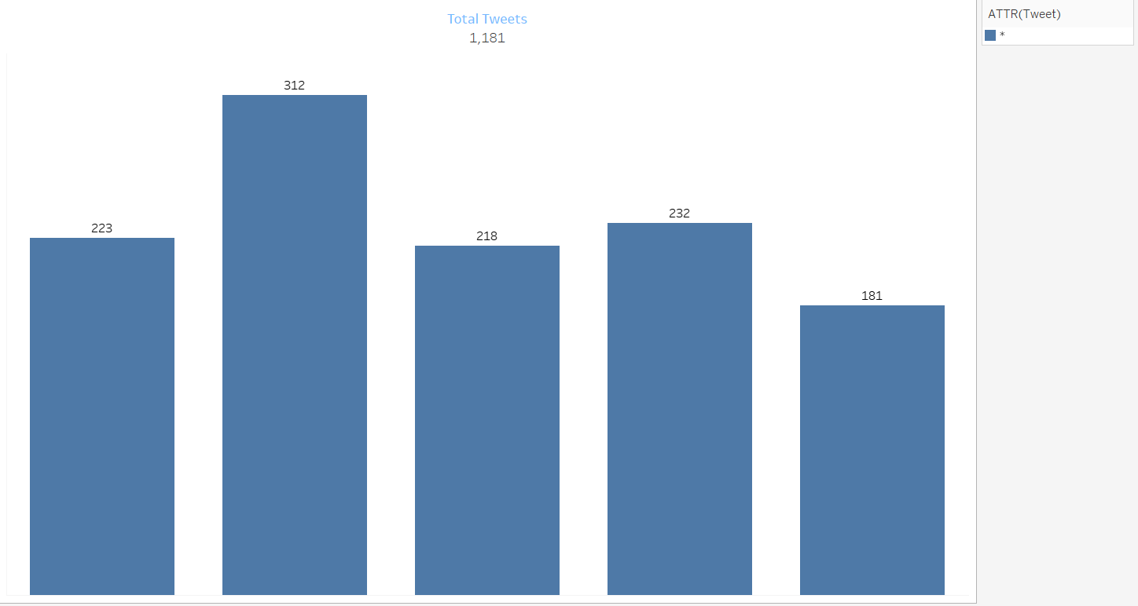
Sumit

Slide 8
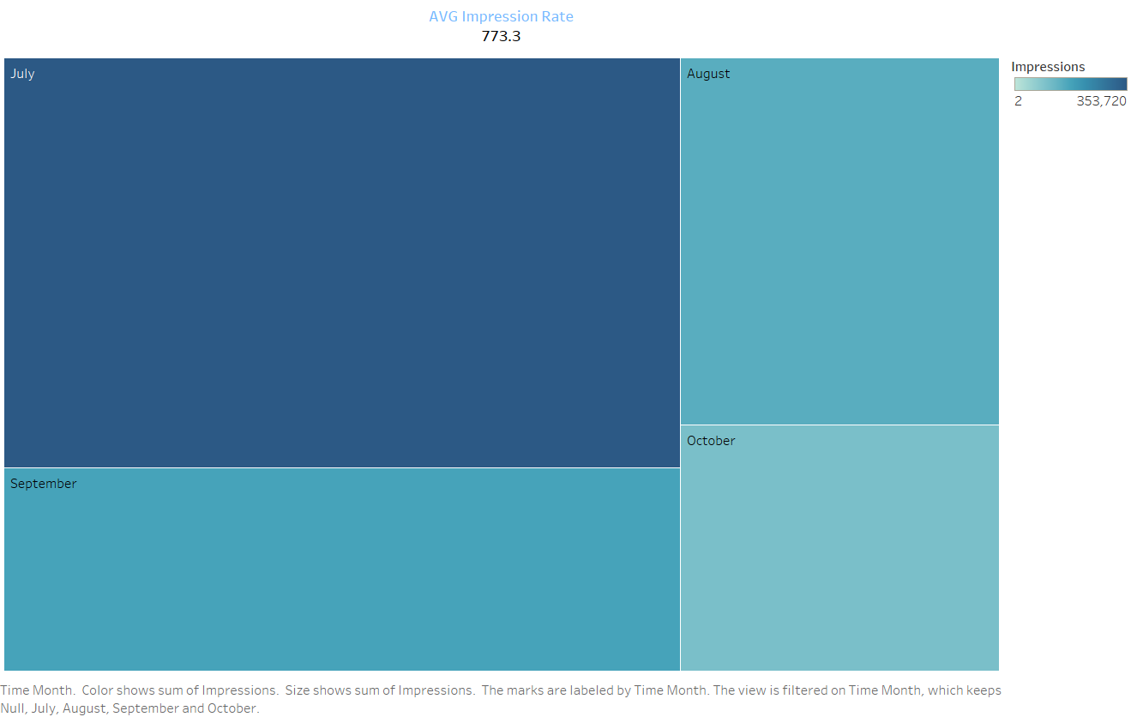
Punam

Slide 9
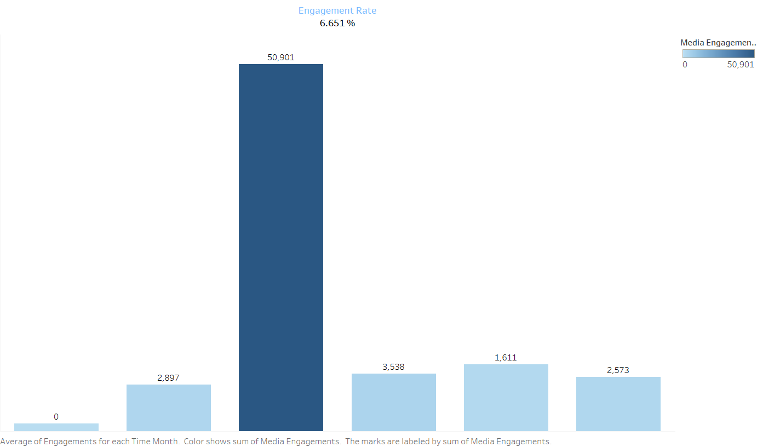
Punam

Slide 10
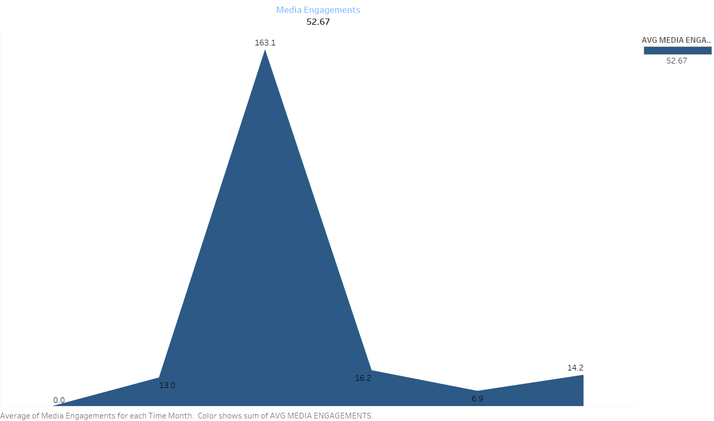
Tejaswini

Slide 11
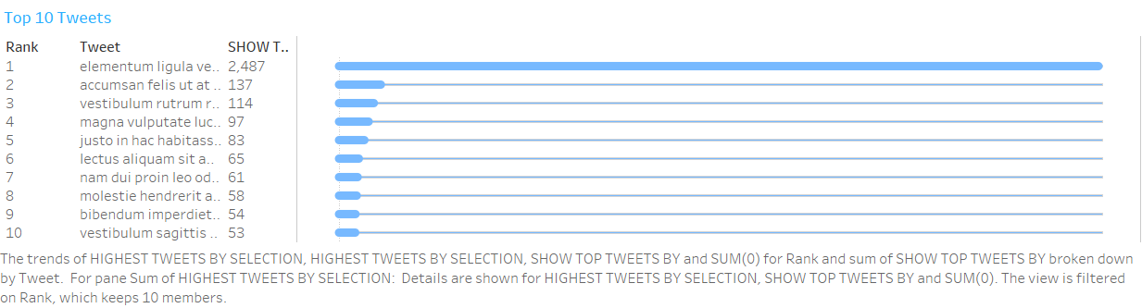
Tejaswini

Slide 12
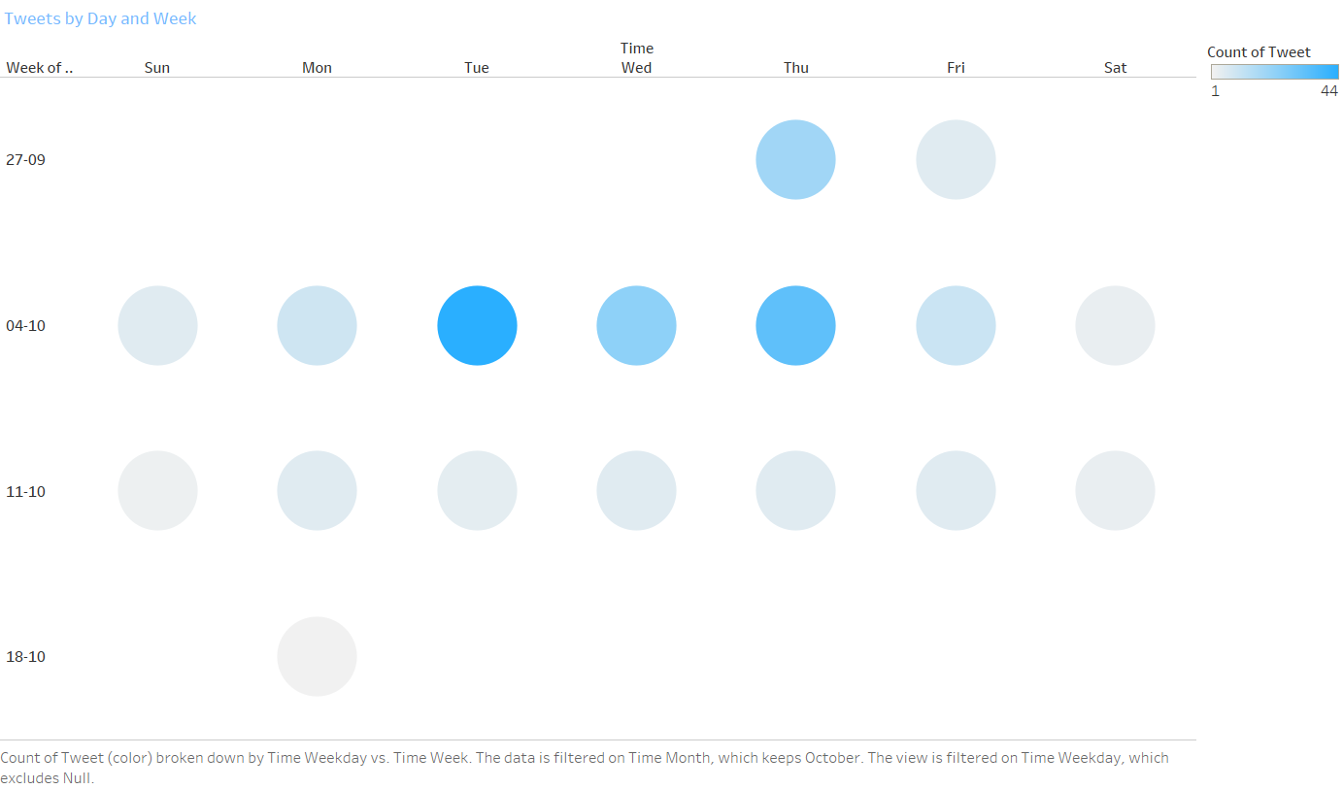
Sadab Ali

Slide 13
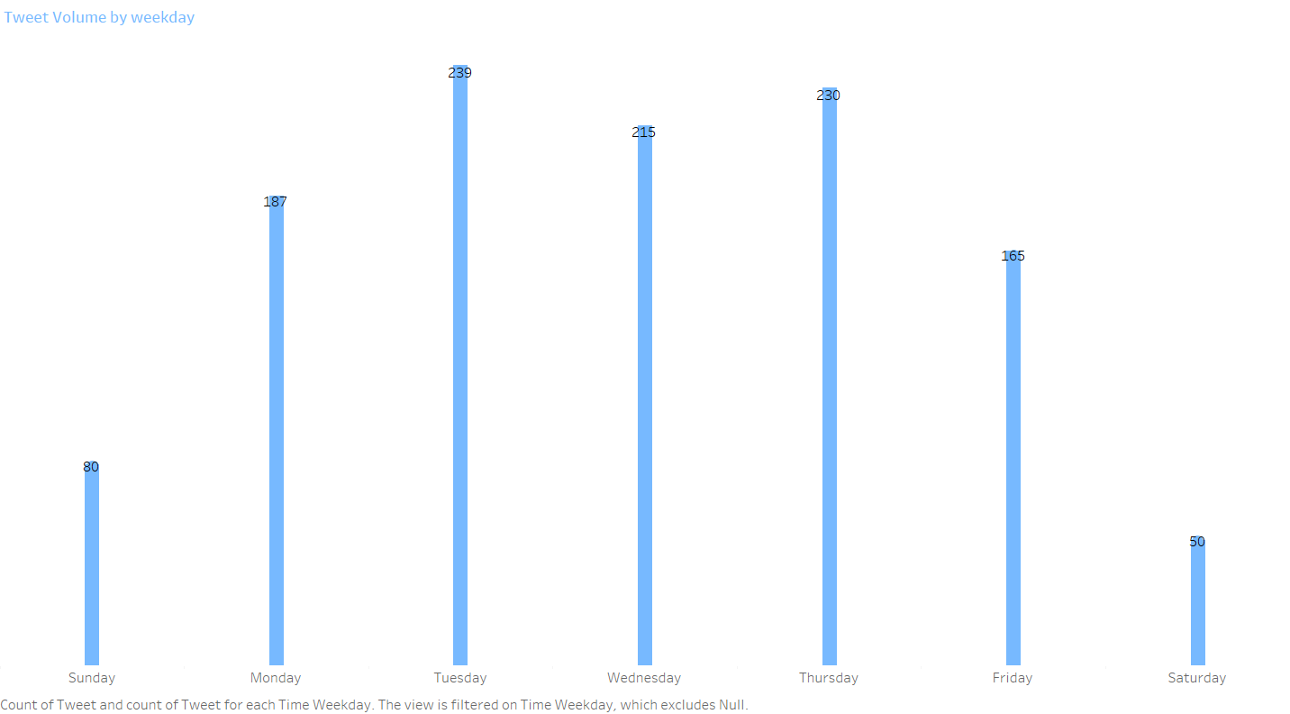
Sadab Ali

Slide 14
